Slide 1

Milestone Meeting #2 - 10/19/18
IT 4983 IT Capstone Project
Stephanie Gray
Ashly Rumery
Julia Huth
Jacob Christensen

Slide 2
Project Summary
Overall project progress
  Completed our second milestone goals a week before our second milestone meeting
  Adding the last few components of the website such as forum topics
Overall accomplishments
  We’ve already started our tests as stated in our test plan

Slide 3
Milestone Summary
All pages from the wireframe created for the website - Completed
Plans developed on how to test website - Completed

Slide 4
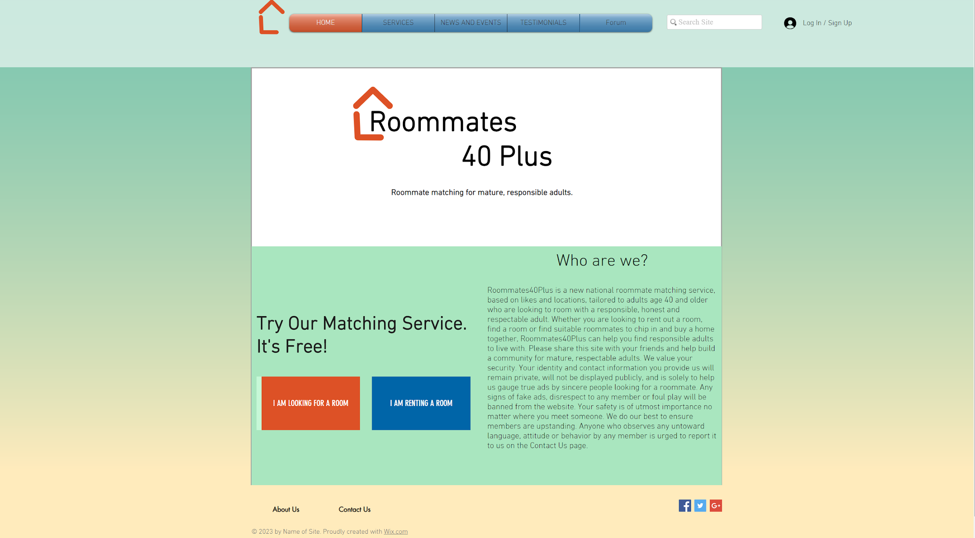
All pages from the wireframe created for the website
Before

Slide 5
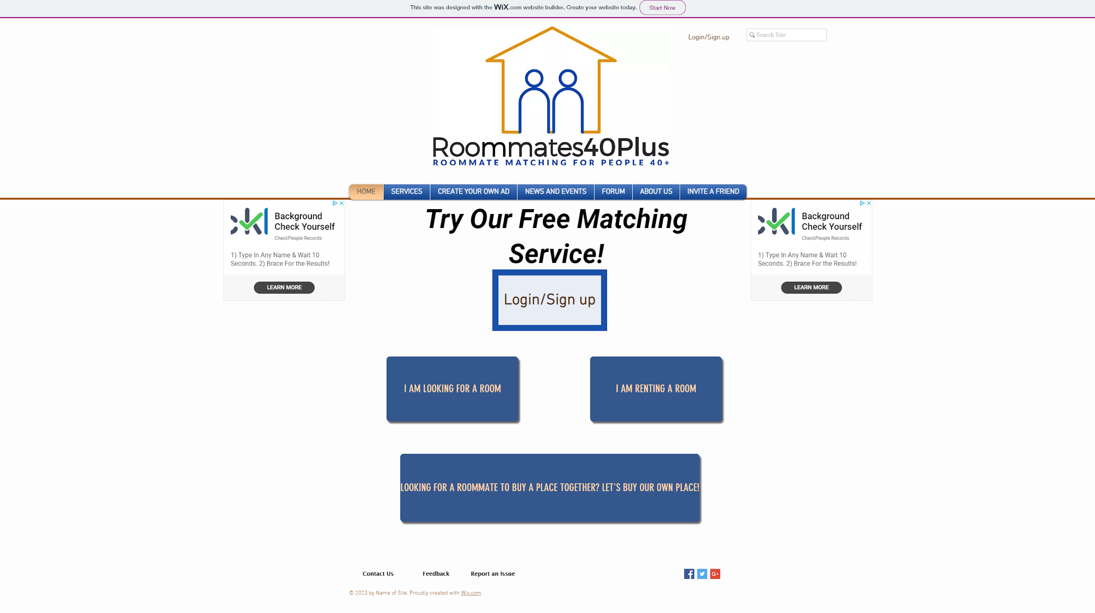
All pages from the wireframe created for the website
After

Slide 6
Plans developed on how to test website
Creating and deleting an account
Creating a profile
Submitting a request, a listing, and an application using Google forms
Creating and paying for an ad
Search and create articles
Creating a post in the forums
Inviting a friend
Find roommate matches
Report an issue
Search bar

Slide 7
Plans developed on how to test website: Creating and deleting an account
There are two “Login/Sign up” buttons on the homepage of the site which will be tested to ensure that they work and that they redirect to the appropriate page.
Creating an account will be done with a fake alias. Once account is created, signing in and deleting the account will be tested.

Slide 8
Plans developed on how to test website: Creating a profile
In the my account profile, the following will be checked to make sure they’re accessible and updated correctly. We will also view other member’s public profile.
Forum Posts
Blog Comments
My Addresses
My Wallet
My Orders
My Account
Notifications
Settings

Slide 9
Plans developed on how to test website: Submitting a form using Google forms
All Google forms will be tested by submitting a form under a fake alias
  Submissions are sent to the email of the owner who created the forms
  Submissions can also be seen under the “Responses” tab of the Google form
After the form is submitted, the email that was used to create the forms will be checked to see if the response was submitted successfully. Also, the “Responses” tab will be checked for the submission.
A spreadsheet of the responses, embedded in different pages of the site, will be checked for the new submissions.
  Google forms updates the spreadsheet every five minutes. So, if a new submission was made, it can be seen on the spreadsheet five minutes after submission.

Slide 10
Plans developed on how to test website: Creating and paying for an ad
The create an ad button will be check to make sure it redirects to the right page
A fake ad will be filled out and submitted
A paypal payment will be made
Once payment has been received, the ad will be created by the site owner and placed on the website
We will also check for a payment confirmation email and an invoice
The site owner will then delete the ad
Money will be refunded

Slide 11
Plans developed on how to test website: Search and create articles
The write an article link will be checked
Scroll current articles, write a comment and like a few of them
Click on create a new article.
Add a picture and a few paragraphs of text
Publish the article
Go back and delete the article
The button to view the news will be check for accuracy and speed of loading the website

Slide 12
Plans developed on how to test website: Creating a post in forums
Creating post in forums will be tested by creating a post and searching and reviewing other fake posts
All functioning buttons will be tested
The post created will have an image, a video and a paragraph of text
Once posted, the posting will be reviewed and liked.
Post will be deleted once testing is complete

Slide 13
Plans developed on how to test website: Inviting a friend
To test this page we will create a fake referral and send it to one of our email accounts
The referral email will be checked against the referral submitted for accuracy and appearance
The referer will also check his/her to ensure they receive a notification that the referral was sent.

Slide 14
Plans developed on how to test website: Report an issue, Contact Page and Feedback page
To test these pages we will create a report and check the dashboard to ensure the message was received.
The report will contain all information being requested for each page.
The owner of the site will delete the reports once it has been acknowledged on the dashboard.

Slide 15
Plans developed on how to test website: Search bar
Testing the search bar will be done by entering a word or phrase in the search field.
We will test to see if search suggestions work.

Slide 16
Plans developed on how to test website: Events Page
For the events page we will open and view each event available
Sign up for a local event
Input our name and email
Check in the dashboard the information has been saved for the participant
The site owner will then delete the events once testing is complete

Slide 17
Project Experience
Challenges
  Adding local events to the website
  Implementing an “invite a Friend” system
  Finding an automated solution to creating your own advertisement
  Finding how to match user entries to each other and display the results
Lessons learned
  Sometimes seemingly easy tasks, such as invite a friend page, can end up taking hours to figure out
Areas to Improve
  We need to work on the look of the site to make all colors and layout match from page to page
  We also need to enlist others to view website to see what they think

Slide 18
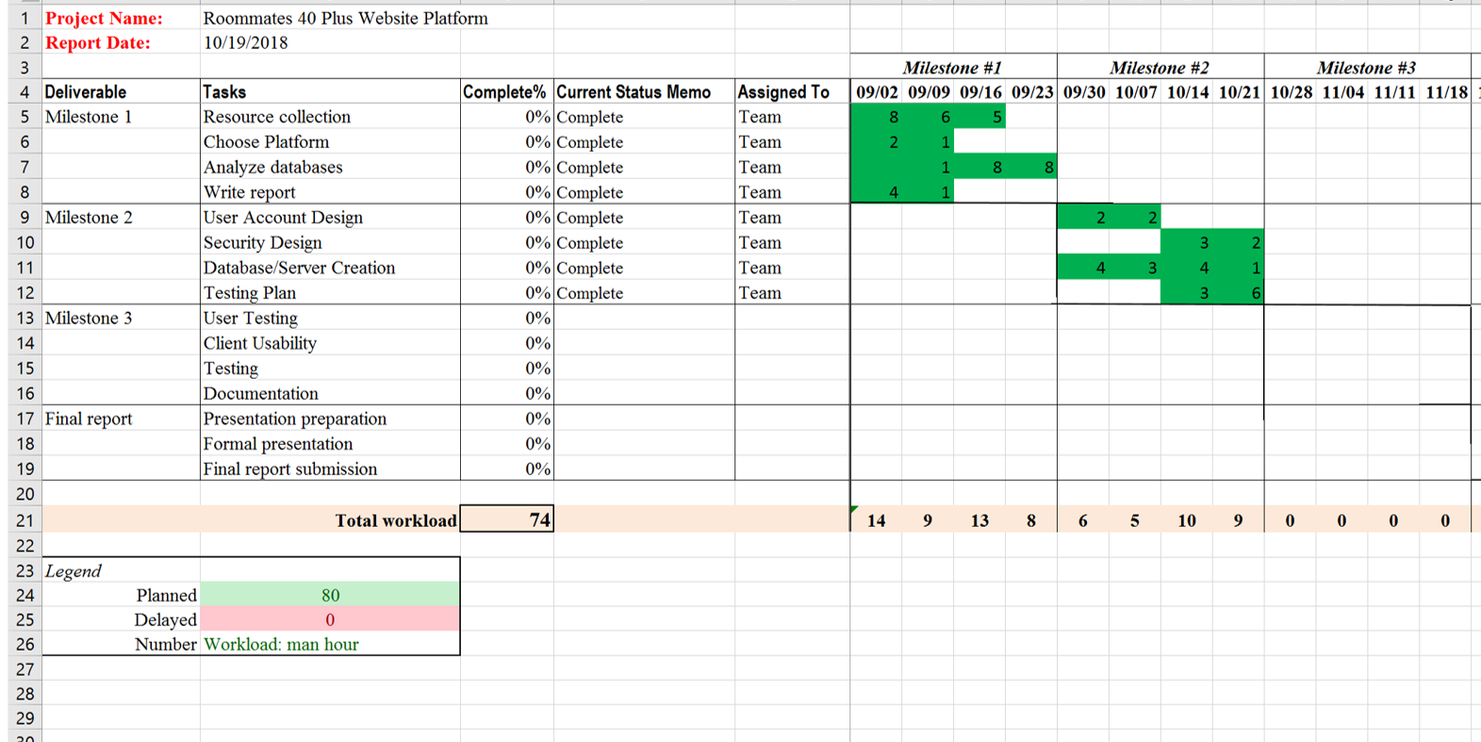
Gantt Chart

Slide 19
Plans for the next phase
By our final milestone meeting, we plan to have all testing done and have the website completely done and functional.

