Slide 1
Roommates 40 Plus
First Milestone Meeting
Stephanie Gray, Ashly Rumery, Julia Huth, and Jacob Christensen
IT 4983 IT Capstone Project
9/21/18

Slide 2
Project Summary
Overall project progress
  Completed our first milestone goals two weeks before our first milestone meeting
Overall accomplishments
  We’ve already started working on the other pages
  We’ve started adding other features, such as forms and a marketing automation platform called Mailchimp.

Slide 3
Milestone Summary
Plan developed and capstone project website created - Completed
Wireframe of website created and approved by stakeholders - Completed
Homepage of website created and approved by stakeholders - Completed

Slide 4
Plan developed and capstone project website created
Capstone project website created
Items added to site so far include
  Planning document
  Project Schedule
  Roommates 40 Plus site address
  Wireframe plan for entire site

Slide 5
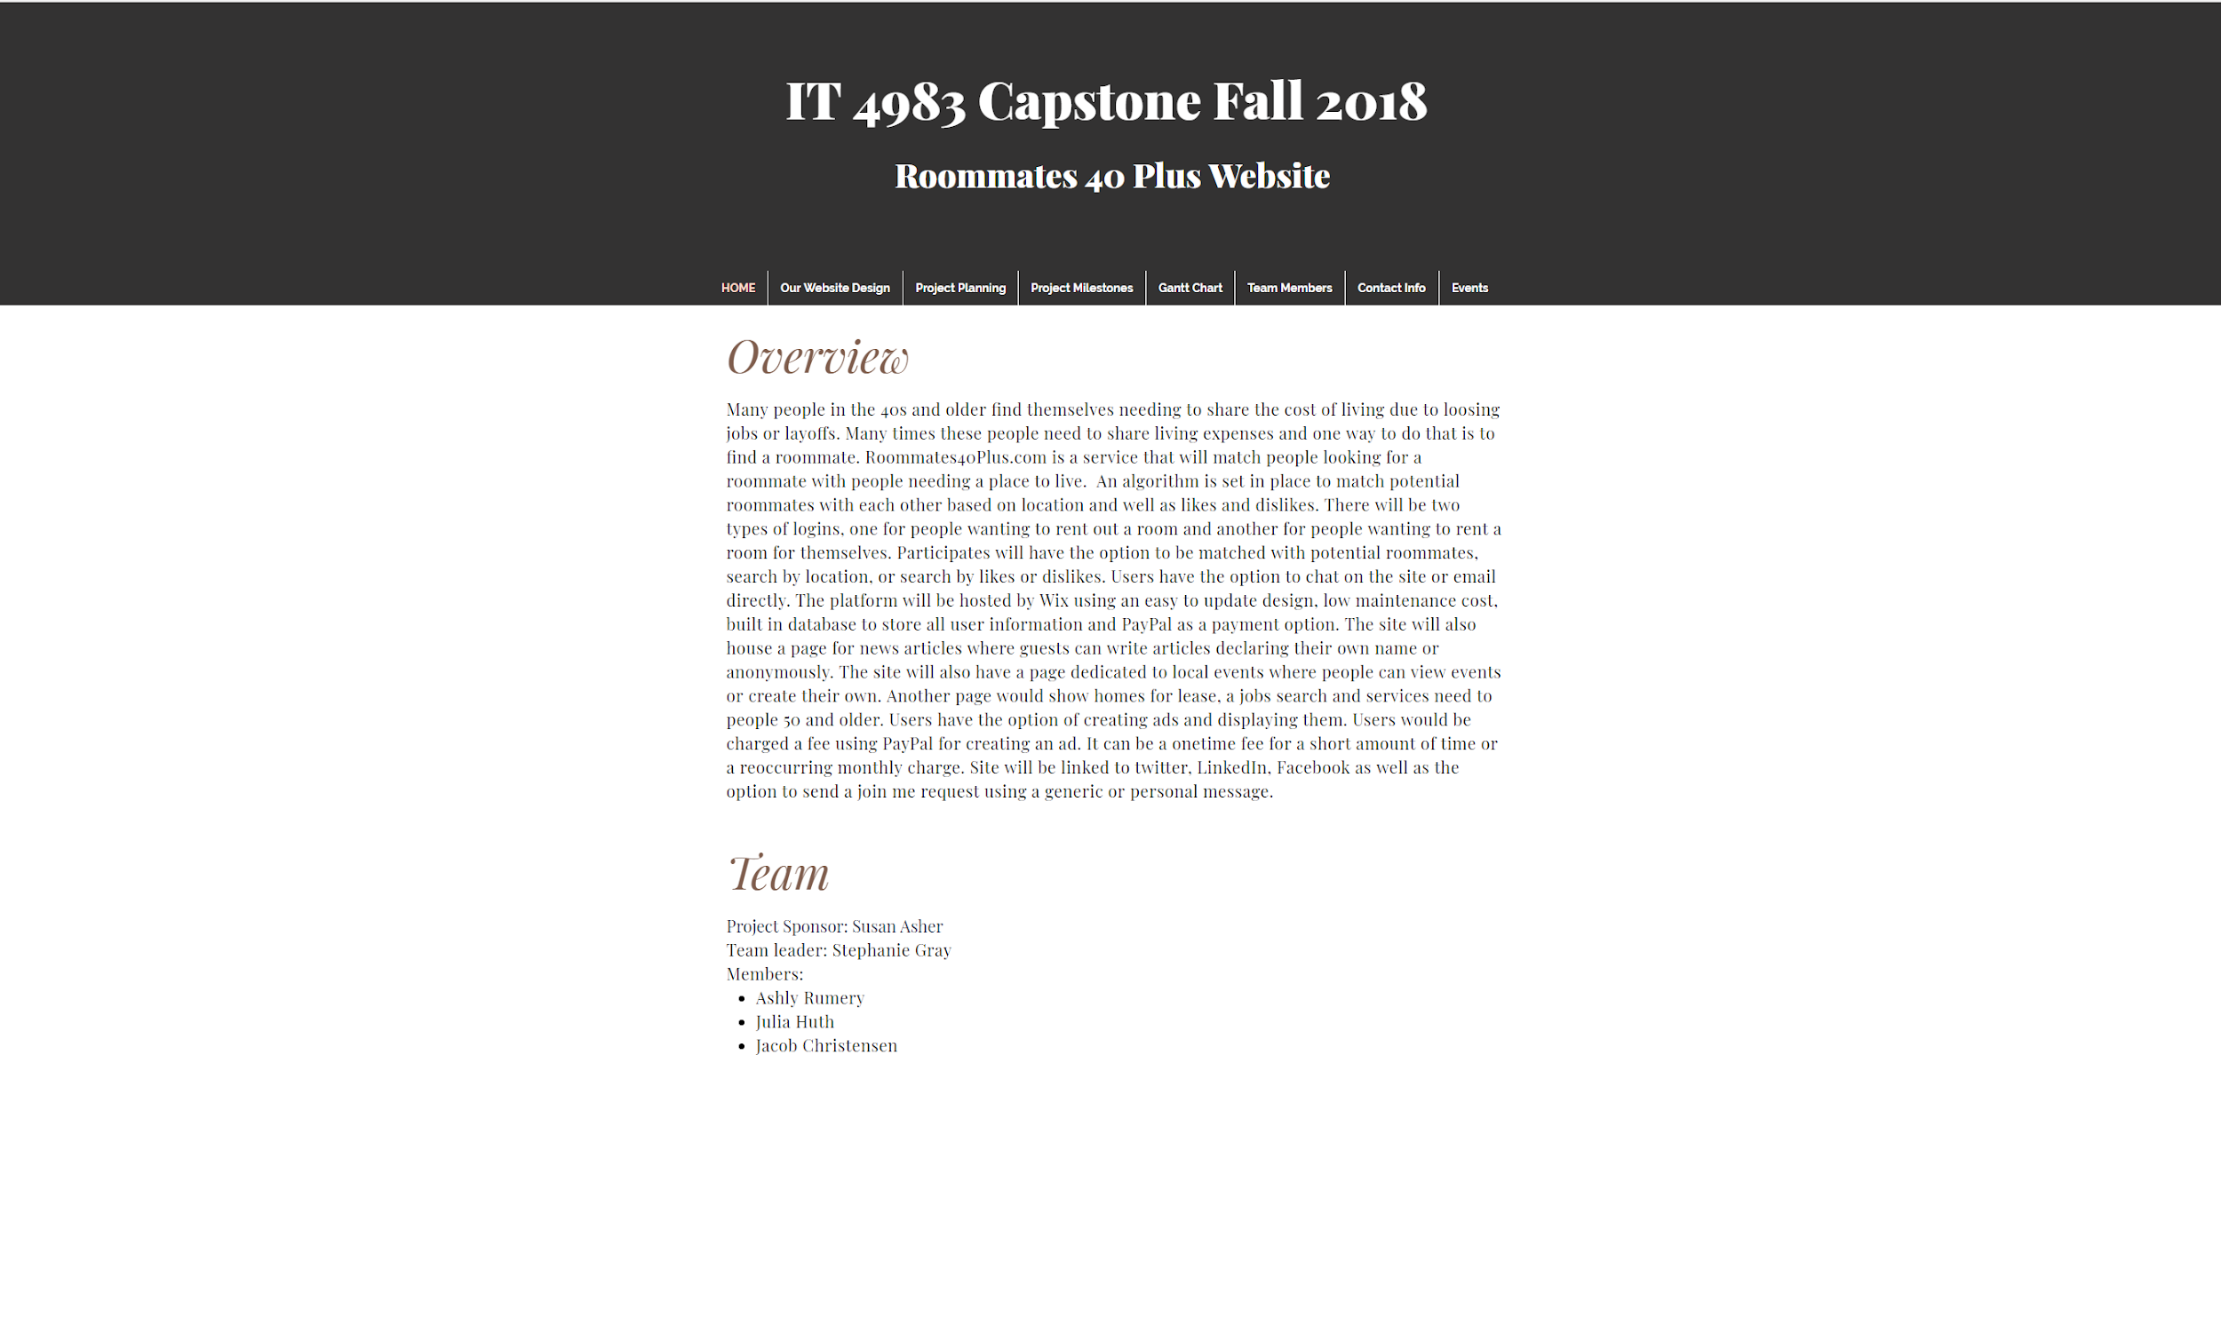
Screenshot of project website
https://arumery.wixsite.com/mysite-3

Slide 6
Wireframe of website created and approved by stakeholders
Susan, our project owner, provided a framework of what she wanted to see on the website:
  A homepage
  A “Looking for a Room” button that would lead to a form for the renter to fill out required information such as, name, address, price range, etc.
  A “Room to Rent” button that would lead the homeowner to fill out required information such as name, address, price, what’s their ideal roommate, etc.
  A “About Us” page
  A “Local Events” page
  A “Services and Products” page
  A “Economic News” page

Slide 7
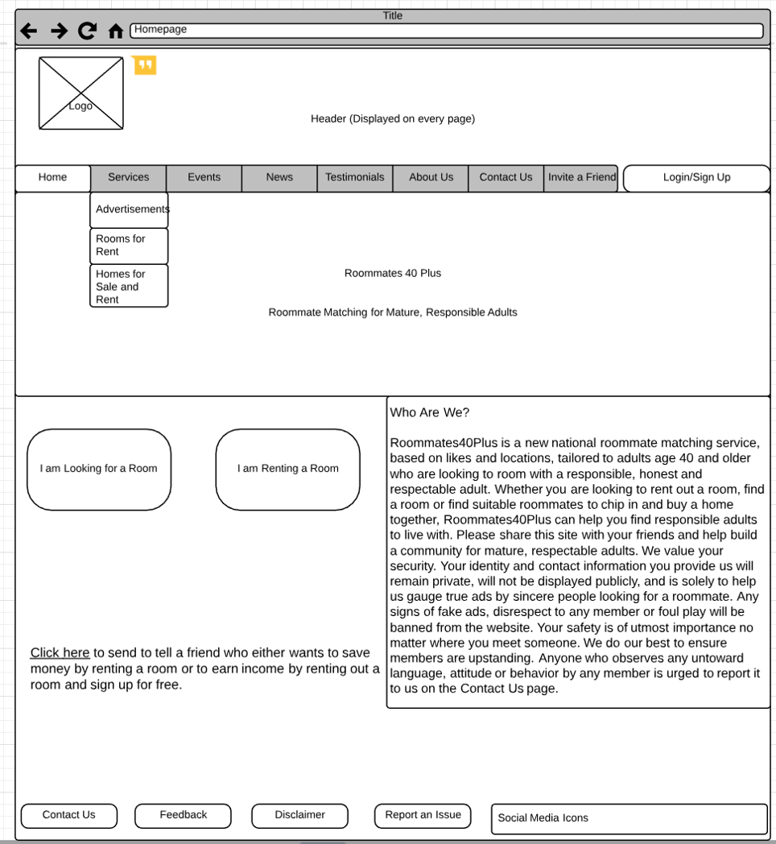
Screenshot of Wireframe Homepage

Slide 8
Homepage of website created and approved by stakeholders
Logo with site name and slogan
A “Who we are?” description box
A search bar
A sign up link to create a profile
A login link to log into a profile
A “Home”, “Services”, “News and Events”, “Testimonials”, and “Forums” tab
A “Looking for a Room” button that would lead to a form for the renter to fill out required information such as, name, address, price range, etc.
A “Room to Rent” button that would lead the homeowner to fill out required information such as name, address, price, what’s their ideal roommate, etc.
About Us and Contact Us at the bottom of the page connect to their respective pages.

Slide 9
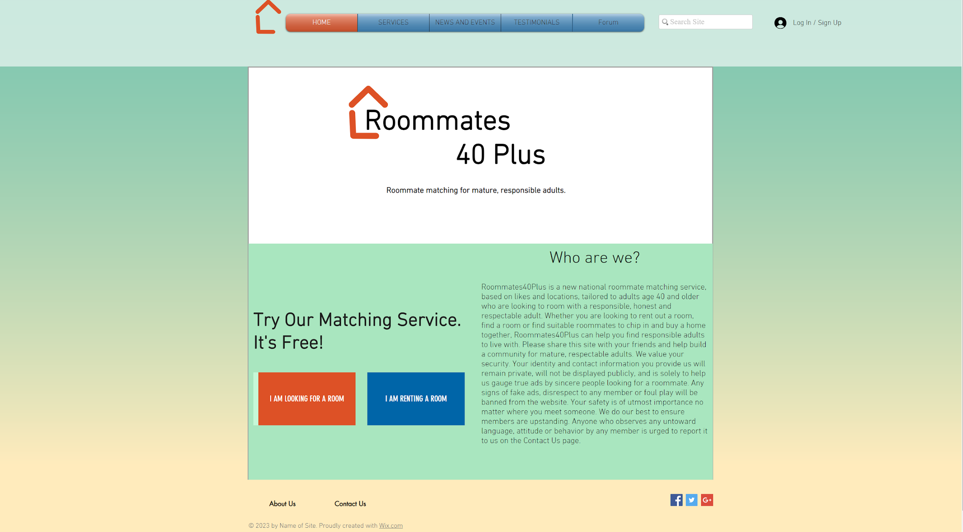
Screenshot of Homepage
https://arumery.wixsite.com/mysite

Slide 10
Project Experience
Challenges
  Adding forms
  Displaying form information
  News and events page that correspond with users location.
Lessons learned
  Test video chat apps before the meeting begins
Areas to improve
  Design
  Form pages
  Matching roommates algorithm
  Member’s profile page
  Services and products page
  Economics news page

Slide 11
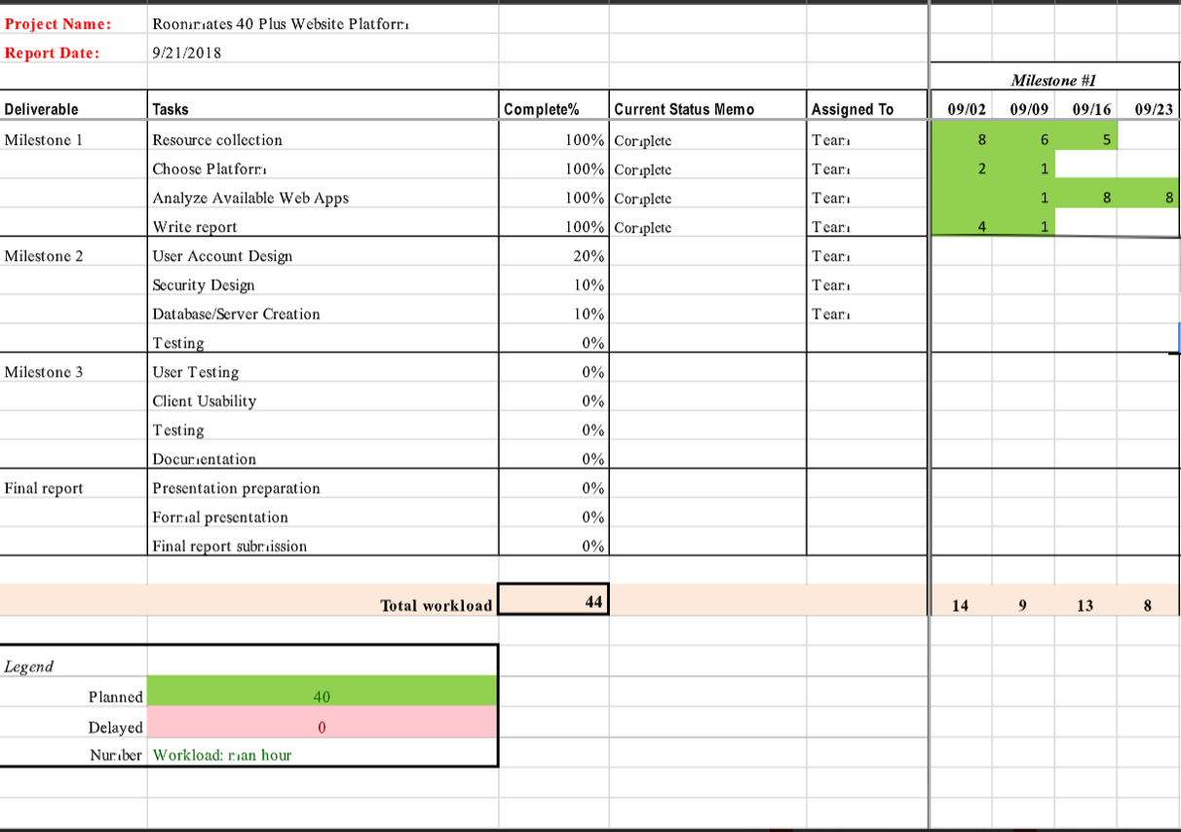
Gantt Chart

Slide 12
Plans for the next phase
By our next milestone meeting, we plan to have all pages from the wireframe created for the website and plans developed on how to test the website.

